Slide 1
Abstract Windowing Toolkit
Object Oriented Programming
AAPP013-4-2
Copyright 2016 Asia Pacific Institute of Information Technology

Slide 2
Developing GUI for Application
Abstract Windowing Toolkit
AWT Basics
Frames
Label , TextField, TextArea & Button
List & Choice
Dialog
Layout Managers
FlowLayout
GridLayout
BorderLayout
Panels

Slide 3
The java.awt package
BorderLayout
CardLayout
FlowLayout
GridLayout
GridBagLayout
Component
Color
Event
Toolkit
Graphics
Dimension
Image
…
Button
Canvas
Container
Checkbox
Choice
Label
List
Scrollbar
TextComponent
Panel
ScrollPane
Window
Applet
Frame
Dialog
Object
TextArea
TextField

Slide 4
Abstract Windowing Toolkit
A rich set of tools provided by Java to help the programmer build Graphical User Interfaces (GUI) with ease.
GUIs built with AWT promises that:
The final interface can run anywhere!
This is unlike many GUI applications which are mainly hardware or operating system dependant.

Slide 5
AWT Basics - Frames
A Frame is a top-level window with a title and a border. In the Java API, it's object hierarchy looks something like this;
java.lang.Object | +--java.awt.Component | +--java.awt.Container | +--java.awt.Window | +--java.awt.Frame
As you can see, the Frame inherits from a long line of superclasses, the immediate one being the Window class

Slide 6
AWT Basics - Frames
import java.awt.*;
public class MyFrame extends Frame {
public static void main(String[] args) { MyFrame me = new MyFrame(); }
public MyFrame() { setSize(150,150); setLocation(100,100); setTitle("My First java.awt.Frame!"); setLayout(new FlowLayout());
setVisible(true); } }

Slide 7
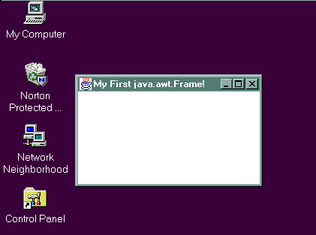
AWT Basics - Frames
setSize() - sets the size of the frame.
setLocation() - sets the location of the frame within the desktop.
setTitle() - sets the title of the frame.
setVisible() - makes the frame visible to the user.
The output of the program might look something like this :

Slide 8
AWT Basics - Label
A Label object is a component for placing text in a container. It is used for displaying a single line of read-only text.
The text can be changed by the application, but a user cannot edit it directly.
The Label object is located in the following API hierarchy;
java.lang.Object | +--java.awt.Component | +--java.awt.Label

Slide 9
AWT Basics - Label
import java.awt.*;
public class MyFrame extends Frame { public static void main(String[] args) { MyFrame me = new MyFrame(); }
public MyFrame() { setSize(150,150); setLocation(100,100); setTitle("My First java.awt.Frame!"); setLayout(new FlowLayout());
Label l = new Label("java.awt.Label"); add(l);
setVisible(true);
}
}

Slide 10
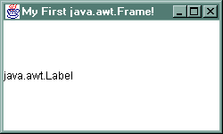
AWT Basics - Label
The output of the program might look something like this :

Slide 11
AWT Basics - TextField
A TextField object is a text component that allows for the editing of a single line of text.
This allows for general user-input.
The TextField object is located in the following API hierarchy;
java.lang.Object | +--java.awt.Component | +--java.awt.TextField

Slide 12
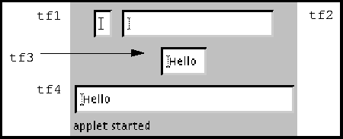
AWT Basics - TextField
TextField tf1, tf2, tf3, tf4; // a blank text field tf1 = new TextField(); // blank field of 20 columns tf2 = new TextField("", 20); // predefined text displayed tf3 = new TextField("Hello!"); // predefined text in 30 columns tf4 = new TextField("Hello", 30);

Slide 13
AWT Basics - TextField
import java.awt.*;
public class MyFrame extends Frame { public static void main(String[] args) { MyFrame me = new MyFrame(); }
public MyFrame() { setSize(150,150); setLocation(100,100); setTitle("My First java.awt.Frame!"); setLayout(new FlowLayout());
Label l = new Label("java.awt.Label"); add(l);
TextField tf = new TextField("java.awt.TextField", 20); add(tf);
setVisible(true);
}
}

Slide 14
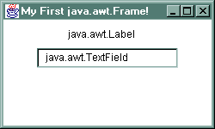
AWT Basics - TextField
The output of the program might look something like this :

Slide 15
AWT Basics - TextArea
A TextArea object is a multi-line region that displays text.
It can be set to allow editing or to be read-only.
The TextArea object is located in the following API hierarchy;
java.lang.Object | +--java.awt.Component | +--java.awt.TextArea

Slide 16
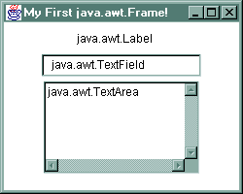
AWT Basics - TextArea
TextArea ta = new TextArea("java.awt.TextArea", 5, 20); add(ta);
By adding the codes above to the previous program, the output of the program might look something like this:

Slide 17
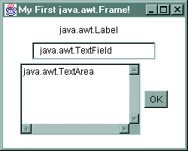
AWT Basics - Button
Button b = new Button("OK"); add(b);
By adding the codes above to the previous program, the output of the program might look something like this:

Slide 18
AWT Basics - List
The List component presents the user with a scrolling list of text items
The List can be set up so that the user can choose either one item or multiple items.
The List object is located in the following API hierarchy;
java.lang.Object | +--java.awt.Component | +--java.awt.List

Slide 19
AWT Basics - List
List lst = new List(4, false);
lst.add("Mercury"); lst.add("Venus"); lst.add("Earth"); lst.add("JavaSoft"); lst.add("Mars"); lst.add("Jupiter"); lst.add("Saturn"); lst.add("Uranus"); lst.add("Neptune"); lst.add("Pluto");
add(lst);

Slide 20
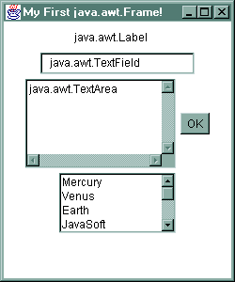
AWT Basics - List
By adding the codes above to the previous program, the output of the program might look something like this:

Slide 21
AWT Basics - Choice
The Choice class presents a pop-up menu of choices.
The Choice object is located in the following API hierarchy;
java.lang.Object | +--java.awt.Component | +--java.awt.Choice

Slide 22
AWT Basics - Choice
Choice c = new Choice();
c.add("red"); c.add("green"); c.add("blue");
add(c);

Slide 23
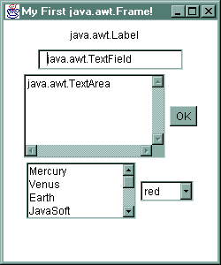
AWT Basics - Choice
By adding the codes above to the previous program, the output of the program might look something like this:

Slide 24
AWT Basics - Dialog
A Dialog is a top-level window with a title and a border that is typically used to take some form of input from the user.
In the API hierarchy, the Dialog inherits from the following line of objects
java.lang.Object | +--java.awt.Component | +--java.awt.Container | +--java.awt.Window | +--java.awt.Dialog

Slide 25
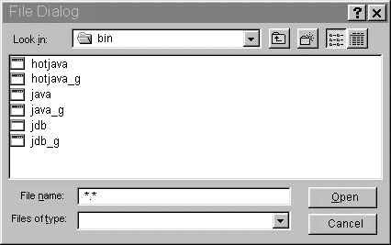
AWT Basics - Dialog
Dialogs are typically used on-top of an existing Window to capture data or display messages to the user.
An example of a typical dialog would be the file-open dialog;

Slide 26
AWT Basics - Dialog
A dialog must have either a frame or another dialog defined as its owner when it's constructed.
A dialog can be either modeless (which is false, default) or modal (true).
A modal dialog is one which blocks input to all other toplevel windows in the app context, except for any windows created with the dialog as their owner.

Slide 27
AWT Basics - Dialog
Creating a Dialog
Dialog d = new Dialog(this, "java.awt.Dialog", true);
d.setSize(100,100); d.setLocation(120,120); d.show();

Slide 28
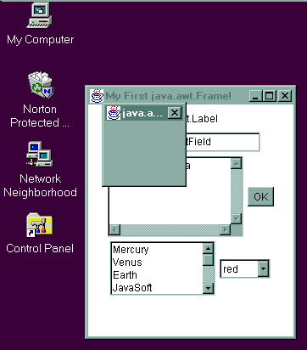
AWT Basics - Dialog
By adding the codes above to
the previous program, the
output of the program might
look something like this:

Slide 29
Layout Managers
In previous code, you might have spotted the following line of code :
setLayout(new FlowLayout());
The setLayout() function, which sets the layout manager for a Container, is defined in the Container class;
java.lang.Object | +--java.awt.Component | +--java.awt.Container
Since Frame class is a child of the Container class, it inherits this functionality.

Slide 30
Layout Managers
What Are Layout Managers?
Layout Managers are tools that helps place controls on a Container object.
There are 5 standard layout managers
Flow Layout
Border Layout
Grid Layout
Card Layout
GridBag Layout
Each of these layout managers is represented by a class of the same name.

Slide 31
Layout Managers
How To Use Layout Managers?
Each of all the layout managers is represented by a class of the same name.
To create a layout manager for your applet :
Create an instance of the appropriate layout class
Call the setLayout() method to tell Java which layout object you want to use.

Slide 32
Layout Managers - FlowLayout
The FlowLayout manager places controls, in the order in which they're added, one after the other in horizontal rows.
In its default state, the FlowLayout manager centers controls on each row.
However, you can set the alignment when you create the layout manager for your applet, like this:
FlowLayout layout = new FlowLayout(align, hor, ver); setLayout(layout);
The FlowLayout constructor takes three arguments :
the alignment (FlowLayout.LEFT, FlowLayout.CENTER, or FlowLayout.RIGHT)
the horizontal spacing between components
the vertical spacing between components

Slide 33
Layout Managers - FlowLayout
Using A FlowLayout
FlowLayout layout = new FlowLayout(FlowLayout.LEFT, 10, 10); setLayout(layout);
button1 = new Button("Button1"); button2 = new Button("Button2"); button3 = new Button("Button3");
add(button1); add(button2); add(button3);

Slide 34
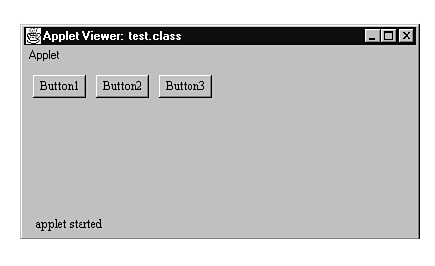
Layout Managers - FlowLayout
Output will look like this :

Slide 35
Layout Managers - GridLayout
The GridLayout manager organizes your applet's display into a rectangular grid, similar to the grid used in a spreadsheet.
Java then places the components you create for the applet into each cell of the grid, working from left to right and top to bottom
You create a GridLayout manager like this:
GridLayout layout = new GridLayout(rows, cols, hor, ver); setLayout(layout);
The GridLayout constructor takes four arguments :
the number of rows
the number of columns
the horizontal space between the grid cells
the vertical space between the grid cells

Slide 36
Layout Managers - GridLayout
Using A GridLayout
GridLayout layout = new GridLayout(2, 2, 0, 0); setLayout(layout);
button1 = new Button("Button1"); button2 = new Button("Button2"); button3 = new Button("Button3"); button4 = new Button("Button4");
add(button1); add(button2); add(button3); add(button4);

Slide 37
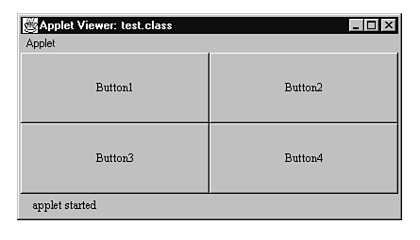
Layout Managers - GridLayout
Output will look like this :

Slide 38
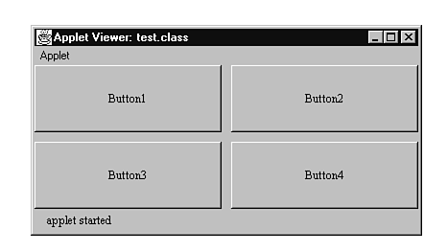
Layout Managers - GridLayout
With horizontal and vertical spacing :

Slide 39
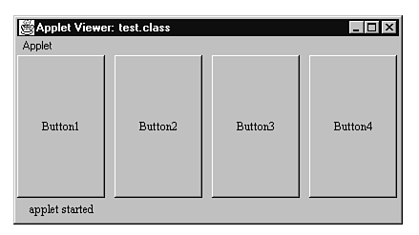
Layout Managers - GridLayout
With 1 row and 4 columns :

Slide 40
Layout Managers - BorderLayout
The BorderLayout manager enables you to position components using the directions north, south, east, west, and center.
You create a BorderLayout manager like this:
BorderLayout layout = new BorderLayout(hor, ver); setLayout(layout);
The GridLayout constructor takes four arguments :
Number of rows
Number of columns
the horizontal spacing between the cells
the vertical spacing between the cells

Slide 41
Layout Managers - BorderLayout
After you create the BorderLayout object, you must add the components using a different version of the add() method :
add(position, object);
Position is where to place the component and must be the string
North
South
East
West
Center
Object is the component you want to add to the applet

Slide 42
Layout Managers - BorderLayout
Using A BorderLayout
BorderLayout layout = new BorderLayout(0, 0); setLayout(layout); button1 = new Button("Button1");
button2 = new Button("Button2"); button3 = new Button("Button3"); button4 = new Button("Button4"); button5 = new Button("Button5");
add("North", button1); add("South", button2); add("East", button3); add("West", button4); add("Center", button5);

Slide 43
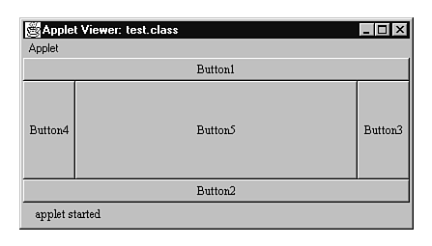
Layout Managers - BorderLayout
Output will look like this :

Slide 44
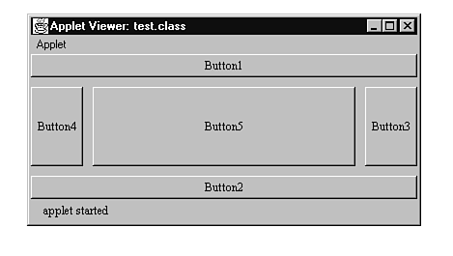
Layout Managers - BorderLayout
With horizontal and vertical spacing :

Slide 45
Panels
The Panel object is located in the following API hierarchy;
java.lang.Object | +--java.awt.Component | +--java.awt.Container | +--java.awt.Panel
A Panel is similar to a Window in that a Panel is a surface that you can place Components.
But a Panel is not a Window; it is a sibling of a Window.

Slide 46
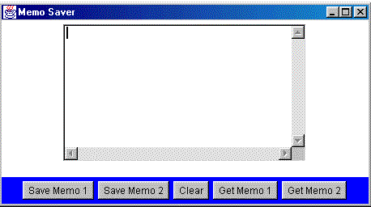
Panels
For example, you can create an application using BorderLayout . Then, within the Center Panel, you can place a TextArea using FlowLayout, and within South Panel, you can place five Buttons using FlowLayout.

Slide 47
Panels
The code that generate the previous GUI :
setLayout(new BorderLayout());
Panel buttonPanel = new Panel();
buttonPanel.setBackground(Color.blue);
buttonPanel.setLayout(new FlowLayout());
Button memo1Button = new Button("Save Memo 1");
buttonPanel.add(memo1Button);
Button memo2Button = new Button("Save Memo 2");
buttonPanel.add(memo2Button);
Button clearButton = new Button("Clear");
buttonPanel.add(clearButton);
Button getMemo1Button = new Button("Get Memo 1");
buttonPanel.add(getMemo1Button);
Button getMemo2Button = new Button("Get Memo 2");
buttonPanel.add(getMemo2Button);
add(buttonPanel,"South");
Panel textPanel = new Panel();
theText = new TextArea(10,40);
textPanel.add(theText);
add(textPanel, “Center");

Slide 48
Summary of Main Teaching Points
Abstract Windowing Toolkit
AWT Basics
Frames
Label , TextField, TextArea & Button
List & Choice
Dialog
Layout Managers
FlowLayout
GridLayout
BorderLayout
Panels

Slide 49
Question and Answer Session
Q & A

Slide 50
Next Session
Event Handling
Examples on Event Handling

